Slide 1

HPC AND HYBRID HPC–BIG DATA CLUSTERS
Prepared by:
Omar Hisham
Soha Yehia
Mohamed Ashour
Supervised by:
Dr. Mohamed Elsayeh

Slide 2
INTRODUCTION
High-Performance Computing (HPC) and Big Data technologies are essential for processing large-scale computational workloads.
This project combines:
HPC using MPI
Big Data processing using Apache Spark
Docker Swarm orchestration
Bioinformatics gene expression analysis
The goal was to build a distributed environment capable of running machine learning workloads efficiently across multiple nodes.

Slide 3

PROJECT OBJECTIVES
Build a 3-node cluster using VirtualBox.
Configure networking and SSH communication.
Implement distributed computing using MPI.
Deploy Apache Spark using Docker Swarm.
Execute distributed machine learning tasks.
Analyze bioinformatics gene expression datasets.

Slide 4
SYSTEM ARCHITECTURE
Cluster Architecture
Master Node
↓
Worker Node 1
↓
Worker Node 2
Node | Role | Node
Master | Cluster Manager | Master
Worker1 | Compute Node | Worker1

Slide 5
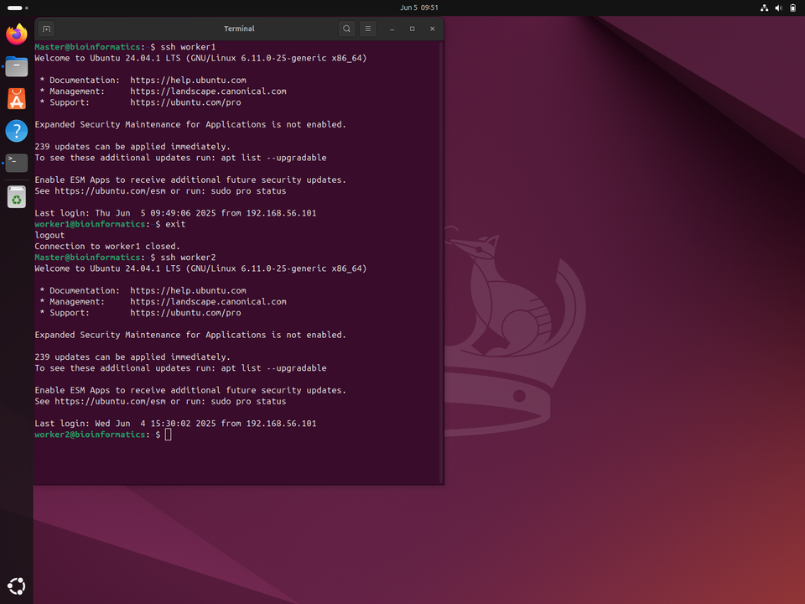

NETWORK AND SSH SETUP
Cluster Setup
Completed Tasks
Installed Ubuntu 24.04 on all VMs.
Configured static IP addresses.
Configured Host-Only Adapter networking.
Added hostnames and hosts file entries.
Enabled passwordless SSH communication.

Slide 6

TASK 1 – MPI CLUSTER
MPI-Based Distributed Computing
Tools Used:
OpenMPI
mpi4py
Python
Cluster Resources:
3 Nodes
6 MPI Processes
Execution Command:
mpirun -np 6 --hostfile hostfile python3 distributed_gene_analysis.py
Insert MPI execution screenshot.

Slide 7
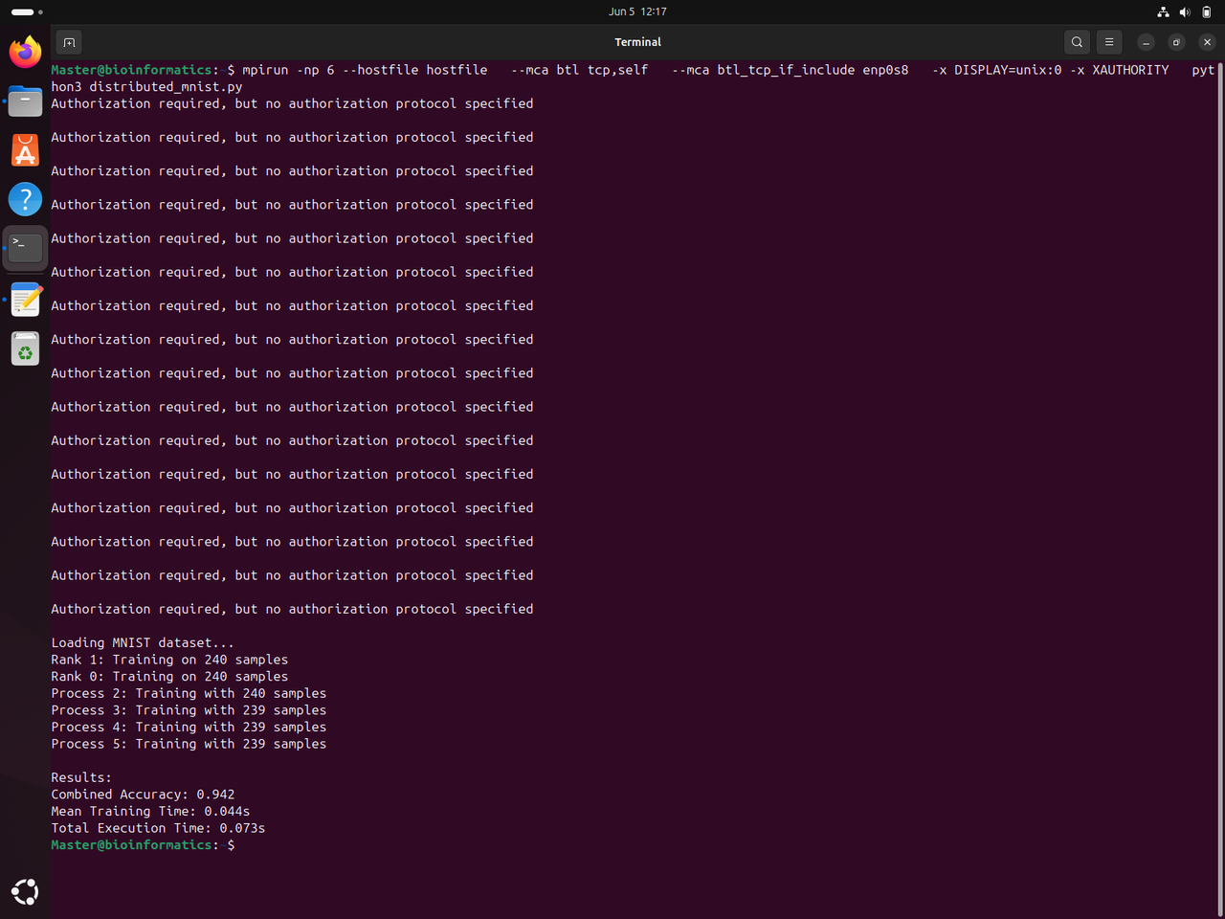


MPI RESULTS
Distributed Processing Results
Workload was distributed across six MPI processes.
Benefits:
Parallel execution
Faster processing
Efficient resource utilization
Results:
Successful execution across all nodes
Correct process communication
Reduced execution time

Slide 8




TASK 2 – SPARK CLUSTER
Hybrid HPC + Big Data Cluster
Technologies:
Docker
Docker Swarm
Apache Spark
Cluster Components:
Spark Master
Spark Worker 1
Spark Worker 2
The cluster was deployed successfully and workers were registered through Spark Web UI.

Slide 9
BIOINFORMATICS ANALYSIS
Gene Expression Analysis
Dataset:
leukemia_expression.csv
Framework:
PySpark ML
Tasks Performed:
Data loading
Distributed processing
Machine learning analysis
Classification workflow

Slide 10
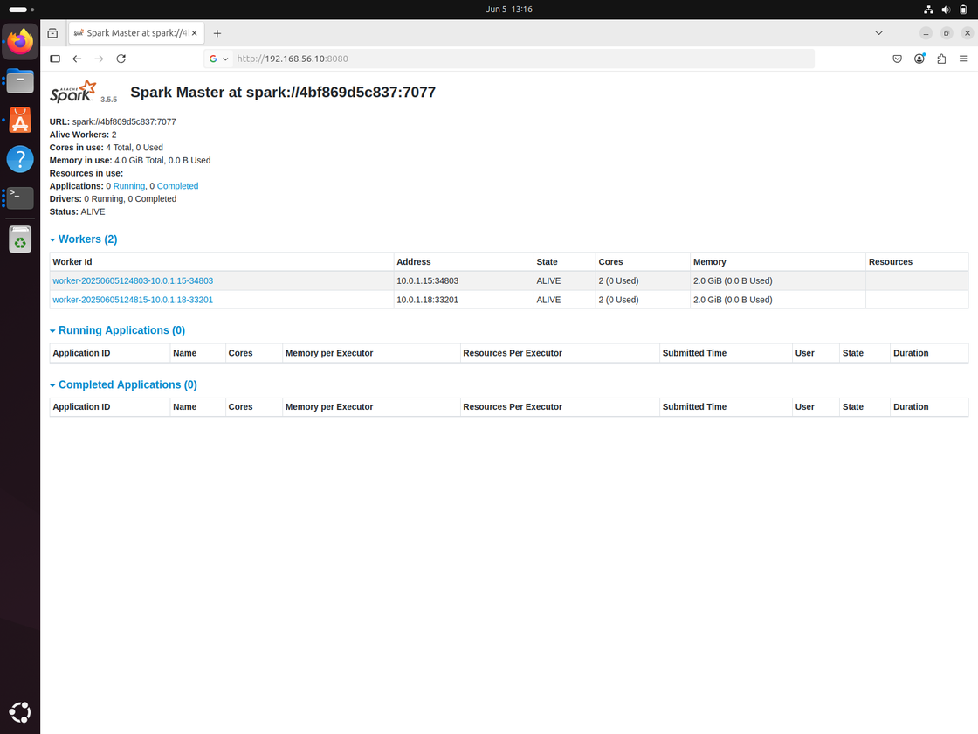
SPARK RESULTS
Cluster Resources:
2 Worker Nodes
4 CPU Cores
4 GB RAM
Achievements:
Successful worker registration
Distributed execution completed
Gene expression analysis performed successfully

Slide 11

CHALLENGES AND SOLUTIONS
CHALLENGES ENCOUNTERED
Network communication issues | Configured static IPs
SSH connection refused | Enabled SSH service
MPI package errors | Installed dependencies
Docker startup failure | Removed conflicting installation
Spark worker connection failure | Updated firewall and networking
PySpark dependency issues | Installed packages inside containers

Slide 12

CONCLUSION
This project successfully implemented:
A traditional HPC cluster using MPI.
A Hybrid HPC–Big Data cluster using Spark.
Distributed machine learning workflows.
Bioinformatics gene expression analysis.
The project provided practical experience in:
HPC
Distributed Computing
Apache Spark
Docker Swarm
Machine Learning
Bioinformatics

Slide 13
THANK YOU

